Slide 1
Machine LEARNING – DAY4
Ekta Vayanan

Slide 2
Data ANAYLSIS
The process of cleaning, transforming, interpreting, analyzing, and visualizing this data to extract useful information and gain valuable insights to make more effective business decisions is called Data Analysis.
Types of Data analysis:
Exploratory Analysis
Descriptive Analysis
Inferential Analysis
Predictive Analysis
Causal Analysis
Mechanistic Analysis

Slide 3
Exploratory data analysis (eda)
Exploratory data analysis is an approach of analyzing data sets to summarize their main characteristics, often using statistical graphics and other data visualization methods.
The analysis of data to discover relationships between measures in the data and to gain an insight on the trends, patterns, and relationships among various entities present in the data set with the help of statistics and visualization tools is called Exploratory Data Analysis (EDA).
Exploratory data analysis is cross-classified in two different ways where each method is either graphical or non-graphical. And then, each method is either univariate, bivariate or multivariate.

Slide 4
Data visualization
Data visualization is defined as a graphical representation that contains the information and the data.
By using visual elements like charts, graphs, and maps, data visualization techniques provide an accessible way to see and understand trends, outliers, and patterns in data.
It is used in many areas such as:
To model complex events.
Visualize phenomenons that cannot be observed directly, such as weather patterns, medical conditions, or mathematical relationships.

Slide 5
Why do we perform data visualization?
The basic uses of the Data Visualization technique are as follows:
It is a powerful technique to explore the data with presentable and interpretable results.
In the data mining process, it acts as a primary step in the pre-processing portion.
It supports the data cleaning process by finding incorrect data and corrupted or missing values.
It also helps to construct and select variables, which means we have to determine which variable to include and discard in the analysis.
In the process of Data Reduction, it also plays a crucial role while combining the categories.

Slide 6
Different types of analysis for data visualization - (eda)
Univariate Analysis: In the univariate analysis, we will be using a single feature to analyze almost all of its properties.
Bivariate Analysis: When we compare the data between exactly 2 features then it is known as bivariate analysis.
Multivariate Analysis: In the multivariate analysis, we will be comparing more than 2 variables.

Slide 7

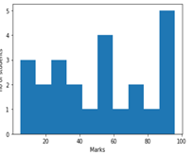
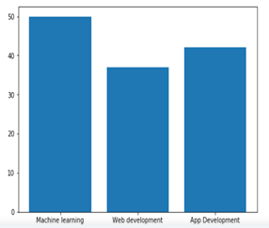
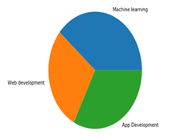
Univariate analysis
The most frequently used graphical illustrations for univariate data are:
Frequency distribution tables.
Bar charts.
Histograms.
Pie charts.

Slide 8
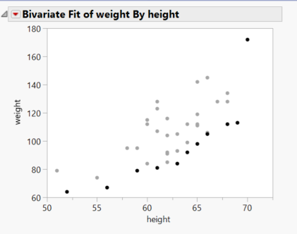
Bivariate analysis
We use a scatter graph to show bivariate data. The correlation between bivariate data demonstrates how strong the relationship is between two variables.

Slide 9
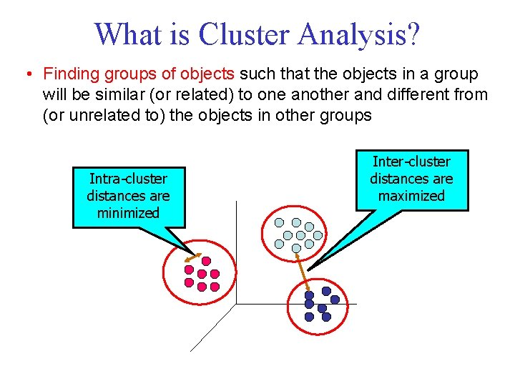
Multivariate analysis
Multivariate analysis is required when more than two variables have to be analyzed simultaneously.
It is a tremendously hard task for the human brain to visualize a relationship among 4 variables in a graph and thus multivariate analysis is used to study more complex sets of data.
Types of Multivariate Analysis include Cluster Analysis, Factor Analysis, Multiple Regression Analysis, Principal Component Analysis, etc.
Cluster Analysis classifies different objects into clusters in a way that the similarity between two objects from the same group is maximum and minimal otherwise. It is used when rows and columns of the data table represent the same units and the measure represents distance or similarity.

Slide 10
Different types of plots
Histogram
Bar charts
Box plot / whisker plot
Scatter plot

Slide 11
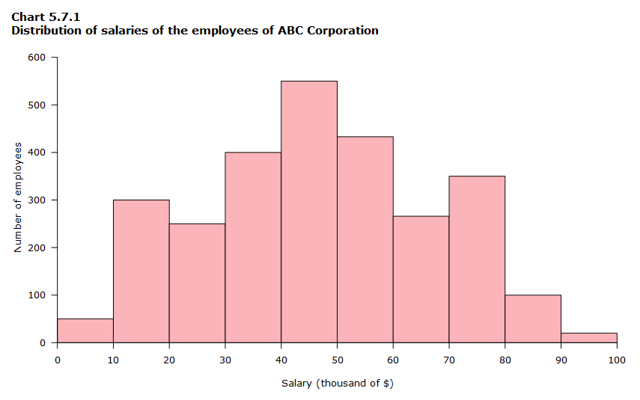
histogram
A histogram is a graphical representation that organizes a group of data points into user-specified ranges. Similar in appearance to a bar graph, the histogram condenses a data series into an easily interpreted visual by taking many data points and grouping them into logical ranges or bins.

Slide 12
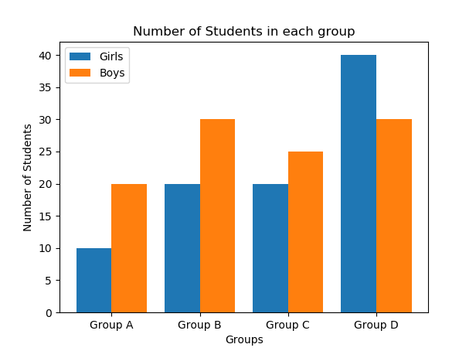
Bar charts
The purpose of a bar graph is to convey relational information quickly as the bars display the quantity for a particular category. The vertical axis of the bar graph is called the y-axis, while the bottom of a bar graph is called the x-axis.

Slide 13
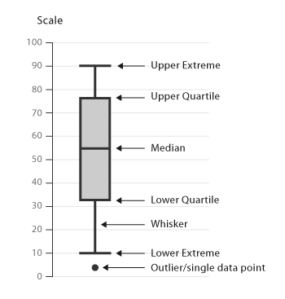
boxplot / whisker plot
Box Plot is the visual representation of the depicting groups of numerical data through their quartiles. Boxplot is also used for detect the outlier in data set. It captures the summary of the data efficiently with a simple box and whiskers and allows us to compare easily across groups. Boxplot summarizes a sample data using 25th, 50th and 75th percentiles. These percentiles are also known as the lower quartile, median and upper quartile.

Slide 14
Scatter plot
A scatter plot (also called a scatterplot, scatter graph, scatter chart, scattergram, or scatter diagram) is a type of plot or mathematical diagram using Cartesian coordinates to display values for typically two variables for a set of data.

